Slide 1
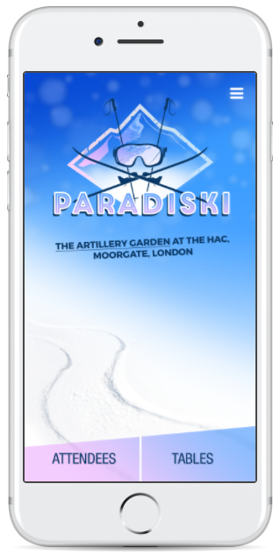

Home Page
ALMR Advert sent with info to be reused.
As per flier Are there any logos needed? No
The two links at the bottom wont be appropriate in this scenario but assume they should be replaced with something else, “Ski Map” and “Itinerary”. Please confirm what these should link too…..Attendees & Ski Map

Slide 2
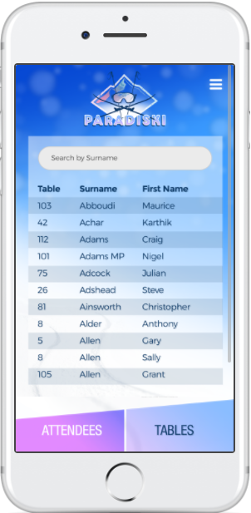
Attendees Page
I Should it be first name, last name and company? Yes RC-S to send …Christian & Surname & Company
enclosed

Slide 3
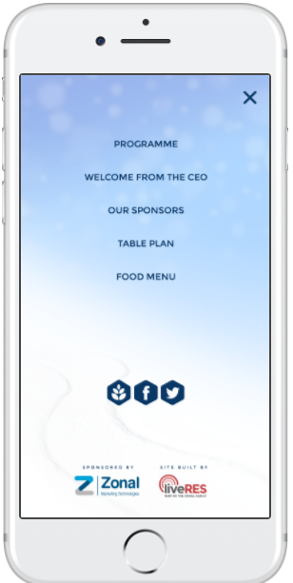
Contents/ Side menu
In this order:
Welcome from ALMR to Paradiski – provided
Itinerary - Outstanding
Ski Map & overview of extent of skiing - SKI Map , Ski Overview & Resort info
Hotel details (big up the ‘door 2 door’ skiing) Provided
Download details to ‘Yuge Paradiki’ App – provided
Details of Ski hire company that will be used –provided
Overview of activities – provided
Branding logos from all ALMR Ski Sponsors –outstanding Thank you cover note for all sponsors & logos

